Slide 1
Time Flies

Slide 2
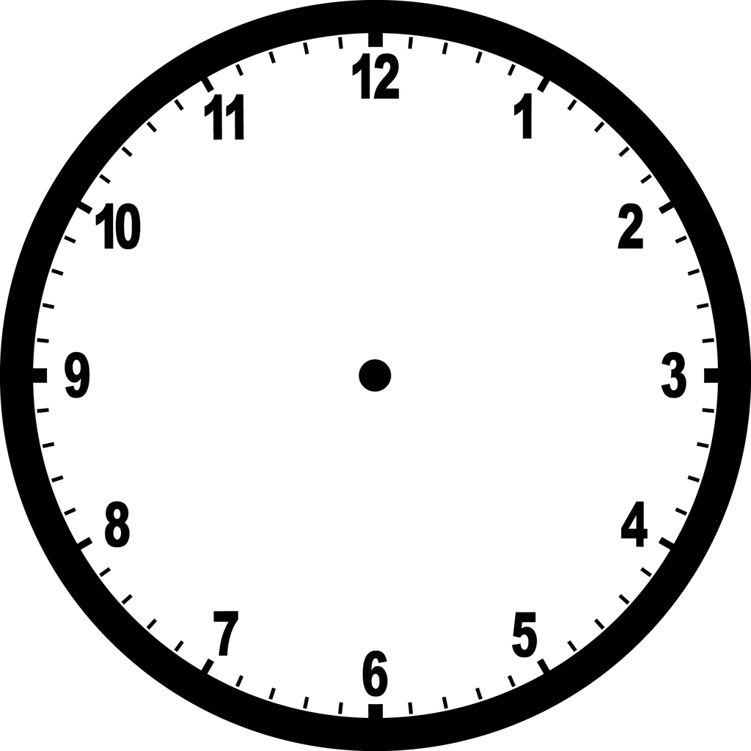
12:00 pm = noon
12:00 am = midnight

Slide 3
past/after

Slide 4
to / of

Slide 5
Quarter past/after

Slide 6
half past/after

Slide 7
Quarter to / of

Slide 8
Four O’clock

Slide 9
Four fifteen
4:15
Quarter past/after four

Slide 10
Four thirty
4:30
Half
past/after four

Slide 11
Four forty five
4:45
Quarter to/of five

Slide 12
Four thirty three
4:33
Twenty seven to/of five

Slide 13
Four twenty
4:20
Twenty past/after four

